Slide 1
Final Project Presentation
Team 21
R12943013 聶家任
R12943126 鄭亦洹

Slide 2
Outline
Algorithm Selection
Modified Gram-Schmidt Hardware Design
Givens Rotation Algorithm
Givens Rotation Hardware Design
Algorithm Comparison
APR Techniques

Slide 3
Outline
Algorithm Selection
Modified Gram-Schmidt Hardware Design
Givens Rotation Algorithm
Givens Rotation Hardware Design
Algorithm Comparison
APR Techniques and Final Results

Slide 4
Algorithm Selection
Modified Gram-Schmidt Process Algorithm
Givens Rotation Algorithm
Householder Reflection Algorithm
Ref: https://en.wikipedia.org/wiki/QR_decomposition

Slide 5
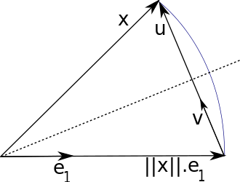
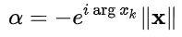
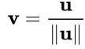
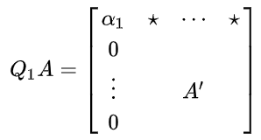
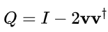
Algorithm Selection
Householder Reflection Algorithm
Imbalance in hardware
Ref: https://en.wikipedia.org/wiki/QR_decomposition

Slide 6

Algorithm Selection
Modified Gram-Schmidt Process Algorithm
Givens Rotation Algorithm
Householder Reflection Algorithm
Ref: Chiueh, Tzi-Dar, Pei-Yun Tsai, and I-Wei Lai. Baseband receiver design for wireless MIMO-OFDM communications. John Wiley & Sons, 2012.

Slide 7
Outline
Algorithm Selection
Modified Gram-Schmidt Hardware Design
Givens Rotation Algorithm
Givens Rotation Hardware Design
Algorithm Comparison
APR Techniques and Final Results

Slide 8
Modified Gram-Schmidt Hardware Design-Inverse Square Root
In MGS Algorithm,the most difficult operation to handle is Inverse Square Root.
In the following slides, we use Newton-Raphson method to calculate this operation.
However, $\frac{1}{\sqrt{X}}$ is highly non-linear, to make the approximation easier, $\frac{1}{\sqrt{1+u}}$ is used instead.
Ref: Prof. Dr. Luigi Carro Orientador. QR Decomposition Algorithms for MIMO Systems

Slide 9
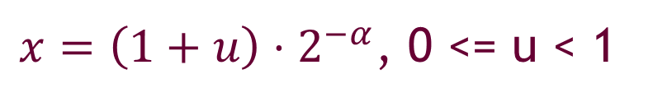
Modified Gram-Schmidt Hardware Design-Inverse Square Root
$x=\left(1+u\right)⋅2^{−α}$, 0 <= u < 1
$$\frac{1}{\sqrt{x}}=\frac{1}{\sqrt{\left(1+u\right)⋅2^{−α}}}=2^{α/2}\frac{1}{\sqrt{1+u}}$$
$α$ is even:
$$\frac{1}{\sqrt{x}}=2^{α/2}\frac{1}{\sqrt{1+u}}=2^{k}\frac{1}{\sqrt{1+u}}$$
$α$ is odd:
$$\frac{1}{\sqrt{x}}=2^{α/2}\frac{1}{\sqrt{1+u}}=2^{\frac{α−1}{2}}\sqrt{2}\frac{1}{\sqrt{1+u}}=2^{k}\sqrt{2}\frac{1}{\sqrt{1+u}}$$
Ref: Prof. Dr. Luigi Carro Orientador. QR Decomposition Algorithms for MIMO Systems

Slide 10
Modified Gram-Schmidt Hardware Design-Inverse Square Root
$$\frac{1}{\sqrt{1+u}}≅0.96582−\frac{1}{4}u−\frac{1}{32}u$$
$$\sqrt{2}\frac{1}{\sqrt{1+u}}≅1.385742−\frac{1}{2}u+\frac{1}{16}u$$
$$y_{i+1}=y_{i}+\frac{y_{i}}{2}−\frac{y_{i}^{2}⋅y_{i}x}{2}$$
Ref: Prof. Dr. Luigi Carro Orientador. QR Decomposition Algorithms for MIMO Systems

Slide 11
Outline
Algorithm Selection
Modified Gram-Schmidt Hardware Design
Givens Rotation Algorithm
Givens Rotation Hardware Design
Algorithm Comparison
APR Techniques and Final Results

Slide 12
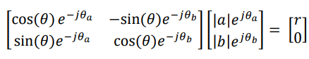
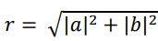
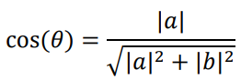
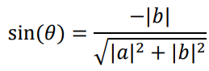
Givens Rotation Algorithm
a
Complex Givens Rotation
b
Ref: Maltsev, Alexander, et al. "Triangular systolic array with reduced latency for QR-decomposition of complex matrices." 2006 IEEE International Symposium on Circuits and Systems (ISCAS). IEEE, 2006.

Slide 13
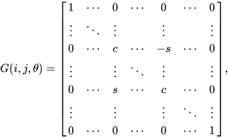
Givens Rotation Algorithm
Givens Rotation Matrix
Ref: https://en.wikipedia.org/wiki/Givens_rotation

Slide 14
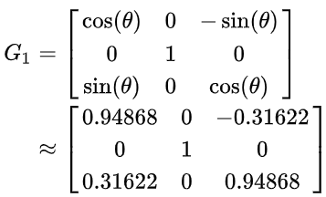
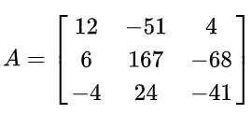
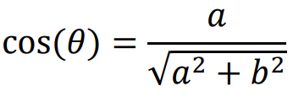
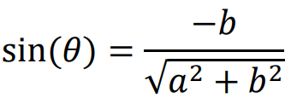
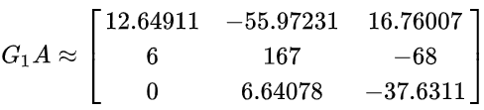
Givens Rotation Algorithm
Example of Givens Rotation
https://en.wikipedia.org/wiki/QR_decomposition

Slide 15
Givens Rotation Algorithm
G
G
Example of Givens Rotation y = Hx
y1
y2
y3
0
*
0
[R|y’]

Slide 16
Outline
Algorithm Selection
Modified Gram-Schmidt Hardware Design
Givens Rotation Algorithm
Givens Rotation Hardware Design
Algorithm Comparison
APR Techniques and Final Results

Slide 17
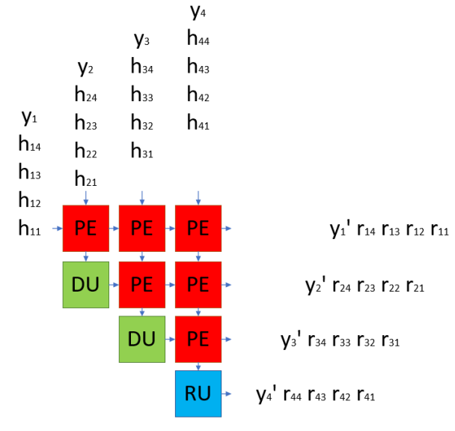
Givens Rotation Hardware Design
Systolic array
Ref: Maltsev, Alexander, et al. "Triangular systolic array with reduced latency for QR-decomposition of complex matrices." 2006 IEEE International Symposium on
Circuits and Systems (ISCAS). IEEE, 2006.

Slide 18
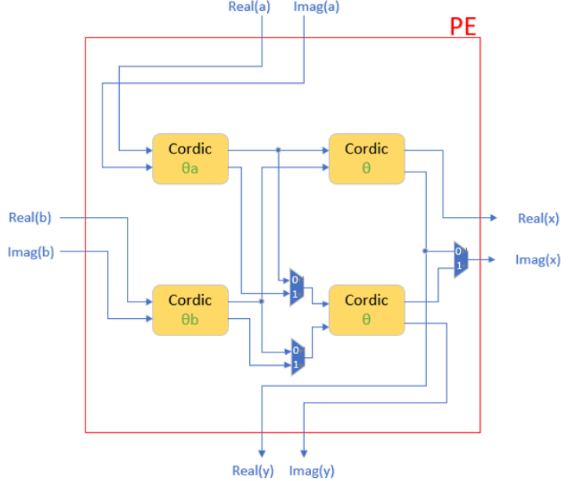
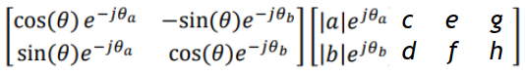
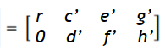
Givens Rotation Hardware Design
PE

Slide 19
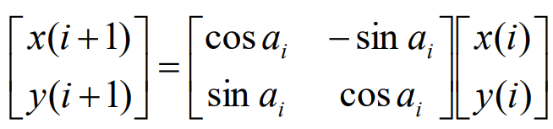
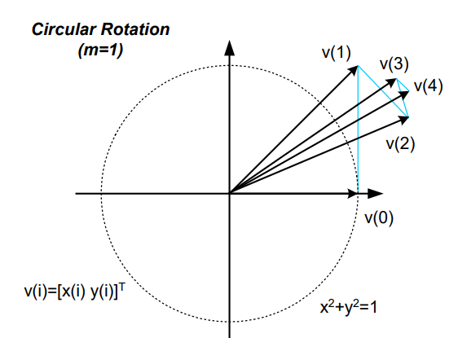
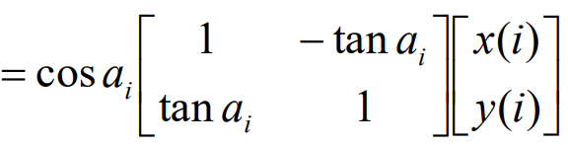
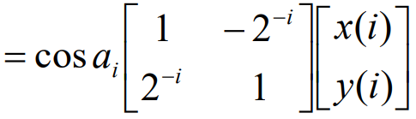
Givens Rotation Hardware Design
COordinate Rotation Digital Computer (CORDIC) is invented to deal with rotation with shift-and-adds
Ref:http://media.ee.ntu.edu.tw/courses/dspdesign/16F/slide/9_processing_elements_design.pdf

Slide 20
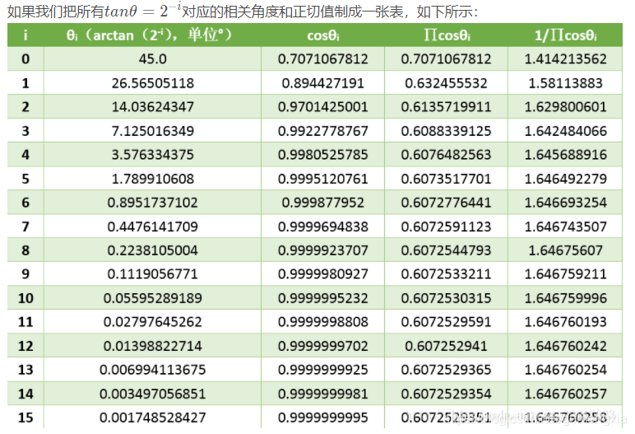
Givens Rotation Hardware Design
CORDIC
1.786912800776°

Slide 21
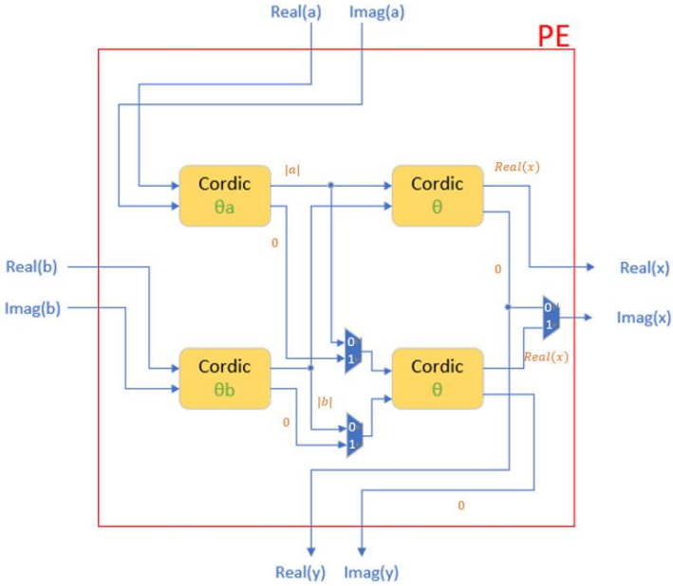
Givens Rotation Hardware Design
a
PE operates in vectoring mode (Mux selects 0)
b

Slide 22
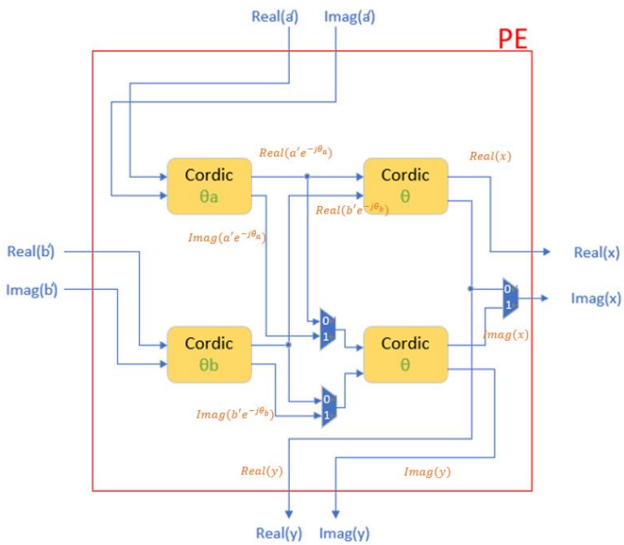
Givens Rotation Hardware Design
a
PE operates in rotation mode (Mux selects 1)
b

Slide 23
Givens Rotation Hardware Design
Every PE should first operate in vectoring mode to record the angles.
When hii gets in PE from the left, PE operates in vectoring mode.
Otherwise, PE operates in rotation mode.

Slide 24
Givens Rotation Hardware Design
Steps of the systolic array
h21
h11
PE
PE
PE
DU
PE
PE
When hii gets in PE from the left, PE operates in vectoring mode.
DU
PE
h11 h12 h13 h14
h21 h22 h23 h24
h31 h32 h33 h34
h41 h42 h43 h44
RU

Slide 25
Givens Rotation Hardware Design
Steps of the systolic array
h22 h31
h11
h12
PE
PE
PE
h21
DU
PE
PE
When hii gets in PE from the left, PE operates in vectoring mode.
DU
PE
h11 h12 h13 h14
h21 h22 h23 h24
h31 h32 h33 h34
h41 h42 h43 h44
RU

Slide 26
Givens Rotation Hardware Design
Steps of the systolic array
h23 h32 h41
h12
h11
h13
PE
PE
PE
h22 h31
h21
DU
PE
PE
When hii gets in PE from the left, PE operates in vectoring mode.
DU
PE
h11 h12 h13 h14
h21 h22 h23 h24
h31 h32 h33 h34
h41 h42 h43 h44
RU

Slide 27
Givens Rotation Hardware Design
Steps of the systolic array
h24 h33 h42
h13 h12
h14
PE
PE
PE
r11
h23 h32 h41
h22 h21
DU
PE
PE
h31
y4
y3
h11 h12 h13 h14
h21 h22 h23 h24
h31 h32 h33 h34
h41 h42 h43 h44
When hii gets in PE from the left, PE operates in vectoring mode.
DU
PE
h44
RU

Slide 28
Givens Rotation Hardware Design
Parameters
Input bit length: TA provides S1.22 while we may not use full of them.
CORDIC coefficient: 0.607253 = 0.100110110111010011112 while we may not add all of them.
CORDIC adder bit length: Use S4.22 to prevent overflow.
CORDIC iteration: Use 15 to have very high accuracy while we may reduce this.

Slide 29
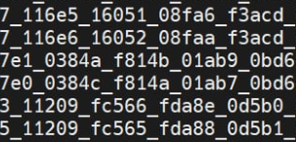
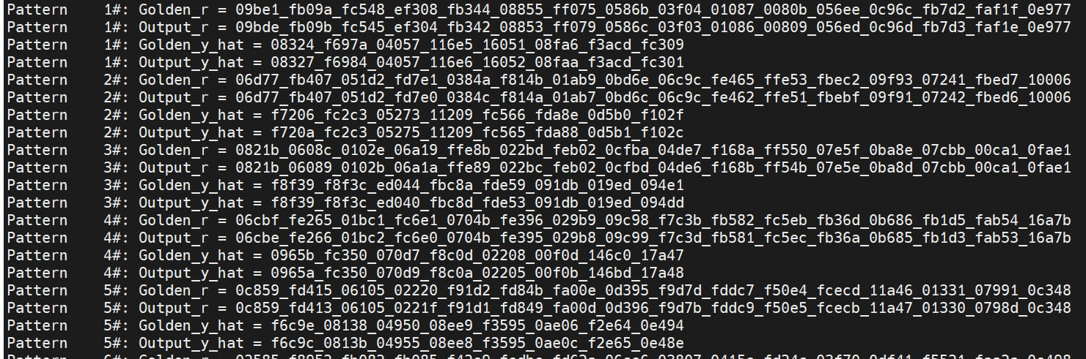
Givens Rotation Hardware Design
Result when CORDIC iteration = 15 (Version 0)

Slide 30
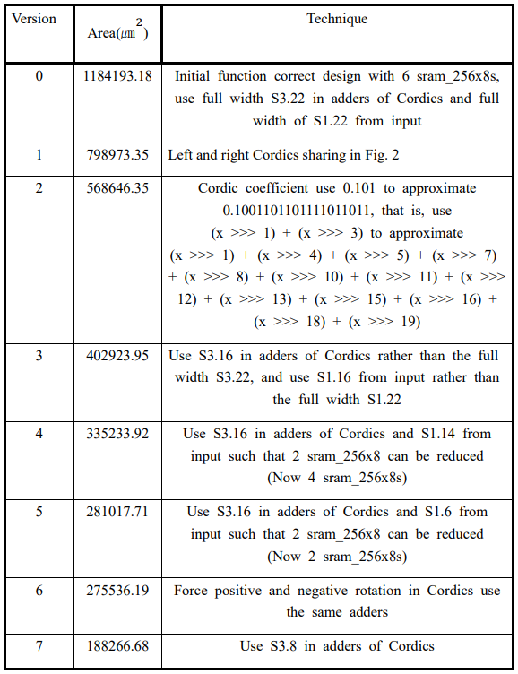
Givens Rotation Hardware Design
Hardware Improvement Process

Slide 31
Givens Rotation Hardware Design
Version 0

Slide 32
Givens Rotation Hardware Design
Version 0 - why we need 6 SRAMs
As i_trig signal is high
Store the four rows of H and y of the first RE into four FIFOs
Save the data of last nine REs into SRAMs
If we use full length of S1.22 from input data
Need to store 24 bits in real data and 24 bits in imaginary data in every cycle
(24+24)/8 = 6 8-bit SRAMs are needed.
Because the data count of the last nine REs are 20*9 = 180 < 256
six sram_256x8s should be used

Slide 33
Givens Rotation Hardware Design
Version 0

Slide 34
Givens Rotation Hardware Design
Version 1

Slide 35
Givens Rotation Hardware Design
Version 2

Slide 36
Givens Rotation Hardware Design
Version 3

Slide 37
Givens Rotation Hardware Design
Version 4

Slide 38
Givens Rotation Hardware Design
Version 5

Slide 39
Givens Rotation Hardware Design
Version 6

Slide 40
Givens Rotation Hardware Design
Version 7 (Final Version)

Slide 41
Outline
Algorithm Selection
Modified Gram-Schmidt Hardware Design
Givens Rotation Algorithm
Givens Rotation Hardware Design
Algorithm Comparison
APR Techniques and Final Results

Slide 42
Algorithm Comparison
In our initial design, due to the pursuit of high accuracy, to make the cycle time of the MGS algorithm less than 5ns, a larger area is required.
Givens Rotation should perform better than MGS.
When the accuracy is not required to be high, the number of multiplier bits used in the MGS algorithm can be greatly reduced, so that the area can be reduced a lot.
There is a chance to beat the Givens Rotation algorithm with the advantage of its short latency.

Slide 43
Outline
Algorithm Selection
Modified Gram-Schmidt Hardware Design
Givens Rotation Algorithm
Givens Rotation Hardware Design
Algorithm Comparison
APR Techniques and Final Results

Slide 44
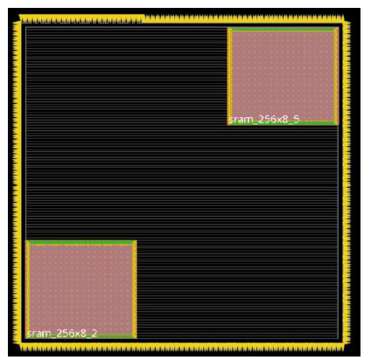
APR Techniques and Final Results
Floorplan Parameter Setting
Floorplan Result
$$Aspect$$ $$Ratio$$ | 1
$$Core$$ $$Utilization$$ | 0.97
$$Core to$$ $left$($\text{μ}m$) | 6
$$Core to$$ $$Right\text{(}\text{μ}m\text{)}$$ | 6
$$Core to$$ $Top$($\text{μ}m$) | 6
$$Core to$$ $$Bottom\text{(}\text{μ}m\text{)}$$ | 6

Slide 45
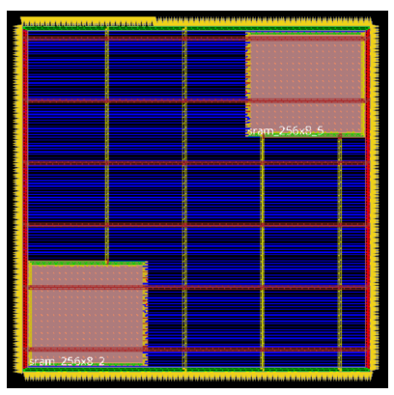
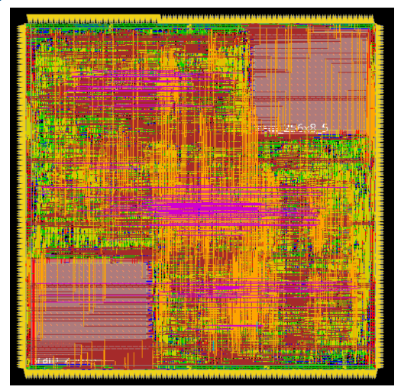
APR Techniques and Final Results
Powerplan Result
APR Final Result

Slide 46
APR Techniques and Final Results
Final Result
 | Result
$$Area$$ (${\text{μ}m}^{2}$) | 187673.03
$$Cycle Time$$ (ns) | 5
$$Time$$ (ns) | 420872
$Power$ (mw) | 15.9
 | Result
$$Performance$$ $Gain$ | 1.54
$$Performance$$ | $$8.16×{10}^{11}$$
$$Ranking$$ | 3

Slide 47
Code Share
https://github.com/joshuanieh/CVSD_Final_QR_Decomposition/tree/main

